Slide 1
Coping With
Chronic Illness
Kari Baber PhD
Department of Child & Adolescent Behavioral Sciences
Department of Pediatrics/Division of Pediatric Gastroenterology, Hepatology & Nutrition

Slide 2
Disclosures
I have no conflicts of interest or financial interest.

Slide 3
The Biopsychosocial model
Biological/
Physiological Processes
Psychological
Traits/
Processes
Social Context
Notes:
Development is ultimately attributed to psychiatrist Geoge Engel (1977) – initial paper challenging traditional biomedical model

Slide 4
Biological/physiological processes
Physical Symptoms/Diagnosis
Medication Effects
Stress Response
Sleep
Genes
Notes:
Among the biological and physiological processes currently included in the biopsychosocial model are, of course, the physical symptoms the individual reports. Some of these are objectively measurable; others are reports of subjective state (including pain, nausea, etc.). The manner in which symptoms and diagnosis are presented to the family can be strongly associated with psychological characteristics/processes, especially beliefs about source/nature/treatability of pain.
Medications may impact some aspects of the individual’s symptoms or produce side effects (i.e., other physical symptoms).
Neuroendocrine activity includes activation of the HPA axis (Hypothalamic-Pituitary-Adrenocortical system), which produces cortisol, a so – called “stress hormone”. Under conditions of “allostatic load” (i.e., stress), HPA function can become dysregulated.
Why Zebras Don’t Get Ulcers (Sapolsky) – now in 3rd edition
Aspects of central nervous system (CNS) function that have been implicated in chronic pain include any number of imbalances of a variety of neurotransmitters, neuromodulators, and their receptors.
Sleep
Importantly, genes can modulate all of the above.

Slide 5
Social context
Family Relationships
Peer Relationships
School/Work
External Stressors

Slide 6
Psychological characteristics/processes
Anxiety/Depression
Coping Style
Internal Stressors
Behavioral Problems

Slide 7
The Biopsychosocial model
Biological/
Physiological Processes
Psychological Characteristics/
Processes
Social Context

Slide 8
Psychosocial risks associated with chronic illness
Impact on Identity
Anxiety/Depression
Behavioral Problems (children)
Social Isolation
Family Stress
School or Work Participation/Performance
Stam et al. 2006
Soliday et al. 2000
Notes:
When we apply the biopsychosocial model, we broaden the lens of what it means to have a chronic illness. We understand that its important to consider the impact of the illness on the individual’s sense of who they are, on their psychological wellbeing, their social relationships and on their functioning at home, at school and in the community.
Stam, H., Hartman, E. E., Deurloo, J. A., Groothoff, J., & Grootenhuis, M. A. (2006). Young Adult Patients with a history
of pediatric disease: Impact on course of life and transition into
adulthood. Journal of Adolescent Health, 39, 4–13.
In a very large, Dutch sample, idividuals with history of pediatric disease (end stage renal disease, cancer, anorectal malformations and Hirschsprung’s disease) achieved social, psychosexual and autonomy developmental milestones later than healthy peers.
Soliday et al. 2000
In a sample of children with steroid sensitive nephrotic syndrome, chronic renal insufficiency, and end stage renal disease compared to healthy peers, researchers found no differences on overall measures of behavioral functioning and family stress. Only among kids with end stage renal disease, post-transplant, were clinically significant elevations on the internalizing scales (CBCL) more common than expected in the general population.

Slide 9
Resilience
“Resilience is the process of adapting well in the face of adversity, trauma, tragedy, threats or significant sources of stress…It means "bouncing back" from difficult experiences”.¹
“In the context of pediatric/health psychology, resilience is the demonstration of emotional, behavioral, or health outcomes that match or surpass normative developmental milestones, behavioral functioning, or emotional well-being, despite exposure to the substantial challenges of living with and managing a medical or developmental condition”.²
American Psychological Association. (2014).
Hilliard et al. (2015)
Notes:
The American Psychological Association tells us that resilience is a process- - specifically, a process of adapting well despite adversity.
Resilience doesn’t mean everyone excels in every area, or that everyone reaches some set standard. Resilience means that adversity shapes, rather than defines, the individual.
.
Today, I want to share with you some research and clinical observations about risk and resilience in youth with functional GI disorders.
Refs.
1. American Psychological Association. (2014). The road to resilience. Washington, DC: American Psychological Association.
2. Hilliard, M.E., McQuaid, E.L., Nabors, L. & Hood, K.K. (2015) Resilience in youth and families living with pediatric health and developmental conditions: Introduction to the special issue on resilience. Journal of Pediatric Psychology, 40(9), 835-839.

Slide 10
Stress and coping
Transactional Model of Stress & Coping
  Stress results from a mismatch between situational demands and coping capacity
No inherently “good” or “bad” coping strategies
Lazarus & Folkman 1984
Compas et al 2001
Notes:
Lazarus, R.S. & Folkman, S. (1984). Stress, appraisal and coping. New York: Springer Publishing Company, Inc.

Slide 11
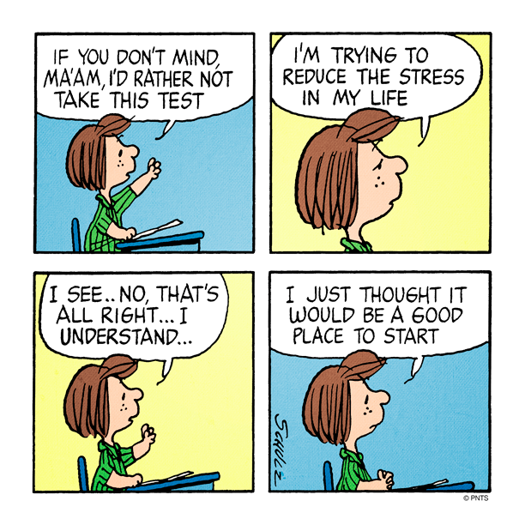

Slide 12
Behavioral health professional’s role
Assessment: areas of strength/need
Patient/family education
Patient/family intervention
Multidisciplinary collaboration
Notes:
Psychiatrist v. psychologist or LCSW or LPC
The psychologist’s role is not always exclusive to the social and psychological contexts. Some of the areas of overlap. For example, sleep assessment/intervention is a particularly appropriate area for psychologists to practice.
Patient/family education is often an ongoing endeavor.
Relation between health and psychological/social factors
Basic tools for relaxation (beneficial both physiologically and psychologically)
Impact of anxiety/depression/stress on pain and vice versa
Importance of sleep
Multidisciplinary collaboration - - dualism is problematic, regardless of which “side” is excluded. Treatment that fails to consider biological/physiological processes is no more grounded in the biopsychosocial model than is treatment than fails to take social contextual and psychological factors into account.
Patient/family intervention: lots of evidence for CBT, with both individual and family based approaches being explored.

Slide 13
Behavioral health interventions support:
Coping with diagnosis
Increasing adherence to treatment plan
Developing adaptive coping skills (illness, stress)
Improving overall functioning (e.g., increasing school attendance, activity re-entry)
Treatment of anxiety, depression or other symptoms
Preparing for transition to adult medical providers

Slide 14
Identifying anxiety
Fears, health related or otherwise
Worry
Avoidance
Changes in sleep or appetite
Increase in fatigue and other physical symptoms

Slide 15
Identifying depression
Sadness/irritability
Withdrawal
Lack of enjoyment of usual activities
Changes in sleep or appetite
Increase in fatigue/loss of energy

Slide 16
Resilience
“Resilience is the process of adapting well in the face of adversity, trauma, tragedy, threats or significant sources of stress…It means "bouncing back" from difficult experiences”.¹
“In the context of pediatric/health psychology, resilience is the demonstration of emotional, behavioral, or health outcomes that match or surpass normative developmental milestones, behavioral functioning, or emotional well-being, despite exposure to the substantial challenges of living with and managing a medical or developmental condition”.²
American Psychological Association. (2014).
Hilliard et al. (2015)
Notes:
The American Psychological Association tells us that resilience is a process- - specifically, a process of adapting well despite adversity.
Resilience doesn’t mean everyone excels in every area, or that everyone reaches some set standard. Resilience means that adversity shapes, rather than defines, the individual.
.
Today, I want to share with you some research and clinical observations about risk and resilience in youth with functional GI disorders.
Refs.
1. American Psychological Association. (2014). The road to resilience. Washington, DC: American Psychological Association.
2. Hilliard, M.E., McQuaid, E.L., Nabors, L. & Hood, K.K. (2015) Resilience in youth and families living with pediatric health and developmental conditions: Introduction to the special issue on resilience. Journal of Pediatric Psychology, 40(9), 835-839.

Slide 17
Tips for coping with chronic illness
Stay informed
Connect with others
Consider the Big Picture
Stay in the moment
Know yourself
Seek help when you need it

Slide 18
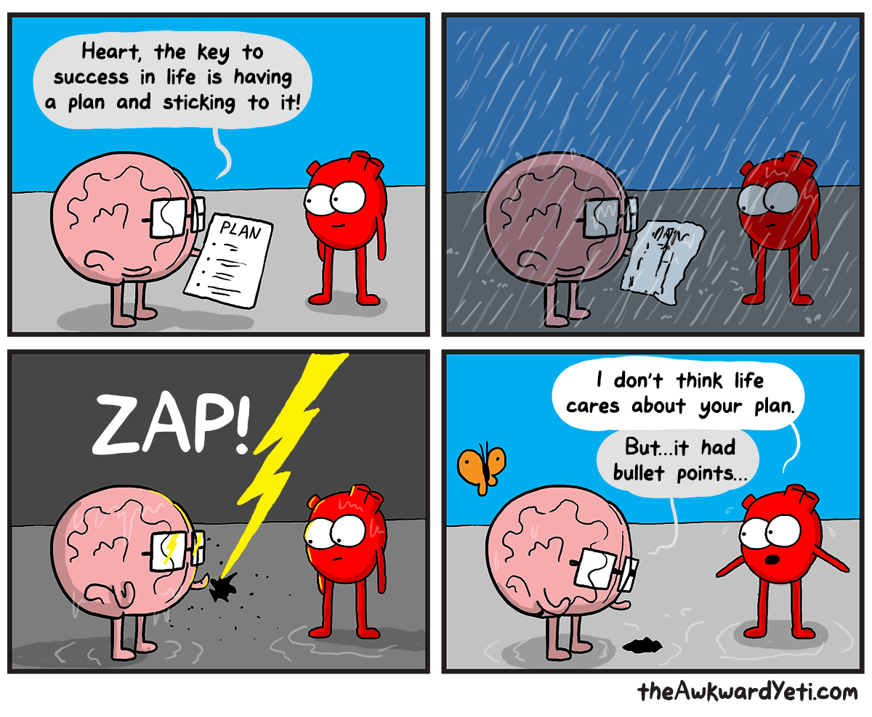

Slide 19
Resources
https://www.apa.org/helpcenter/stress-facts.pdf
Information about stress and its effects from the American Psychological Association.
http://www.aacap.org
Facts for Families from the American Academy of Child and Adolescent Psychiatry
http://effectivechildtherapy.com
Information about evidence-based treatment for anxiety, depression and other childhood behavioral health problems

Slide 20
References
American Psychological Association. (2014). The road to resilience. Washington, DC: American Psychological Association.
Compas BE, Connor-Smith JK, Saltzman H et al. Coping with stress during childhood and adolescence: Problems, progress, and potential in theory and research. Psychological Bulletin. 2001; 127:87–127.
Hilliard ME, McQuaid EL, Nabors L et al. Resilience in youth and families living with pediatric health and developmental conditions: Introduction to the special issue on resilience. Journal of Pediatric Psychology. 2015; 40: 835-839.

Slide 21
References
Lazarus, R.S. & Folkman, S. (1984). Stress, appraisal and coping. New York: Springer Publishing Company, Inc.
Stam H, Hartman EE, Deurloo JA et al. Young adult patients with a history of pediatric disease: Impact on course of life and transition into adulthood. Journal of Adolescent Health. 2006; 39: 4–13.
Soliday E, Kool F, Lande MB. Psychosocial adjustment in children with kidney disease. Journal of Pediatric Psychology. 2000; 25:93-103.

