Slide 1
ARPKD: in the kidney
Erum Aftab Hartung, MD, MTR
Assistant Professor of Pediatrics
Division of Nephrology, CHOP
Perelman School of Medicine at the University of Pennsylvania
ARPKD-CHF Conference: Empowering the Patient
Saturday November 3, 2018

Slide 2
Background & Disclosures
Attending Physician in CHOP Division of Nephrology
Co-Director of Combined Kidney-Liver Program (with Dr. Jessica Wen)
Member of Scientific Advisory Committee and PKD in Children Council of the PKD Foundation
Research funding: NIH/NIDDK and Kadmon Corporation (clinical trial)

Slide 3
My goals for today
To review:
  what the kidneys do
  how kidney cysts form and grow
  differences and similarities between ARPKD and ADPKD
  clinical features of ARPKD
  long-term kidney outcomes in ARPKD

Slide 4
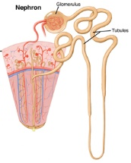
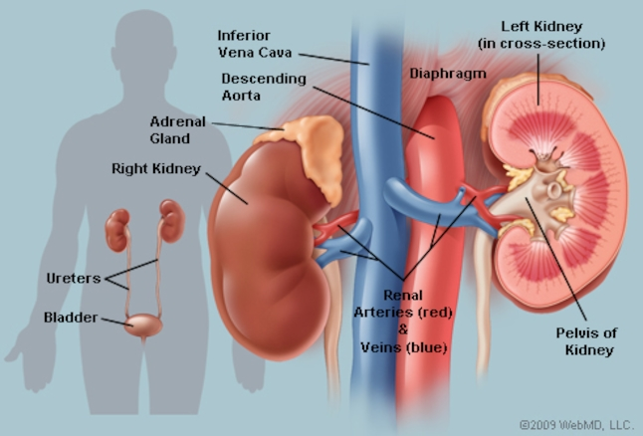
Kidneys 101
Nephron
Glomerulus
Tubules
https://www.webmd.com/kidney-stones/picture-of-the-kidneys#1
https://my.clevelandclinic.org/health/diseases/15096-kidney-disease-chronic-kidney-disease

Slide 5
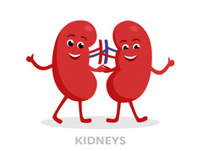
What do the kidneys do?
Get rid of waste products from the body
Control the body’s fluid balance
Regulate levels of the body’s electrolytes (chemicals such as sodium, potassium, and bicarbonate)
Regulate blood pressure
Make a hormone called erythropoietin (“EPO”) that tells the body to make red blood cells
Activate vitamin D, which is important for bone health

Slide 6
What is chronic kidney disease (CKD)?
CKD means that the kidneys are not fully able to perform all their normal functions
CKD can be caused by many different diseases, including ARPKD
Kidney function is measured using glomerular filtration rate (GFR)
  calculated based on blood creatinine (± cystatin C) levels
  Can be thought of as “percent” kidney function (is actually measured in mL/min/1.73m²)

Slide 7
CKD Stages
CKD Stage | Description | GFR
1 | Mild, normal GFR | ≥90
2 | Mild | 60-89
3 | Moderate | 30-59
4 | Severe | 15-29
5 | Severe (end-stage kidney disease, ESRD/ESKD) | <15

Slide 8
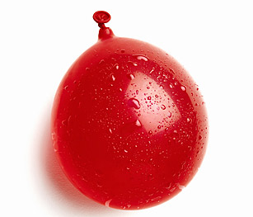
What is a cyst?
A fluid-filled structure – like a water balloon
Why do cysts form and grow?
  The cells lining the “walls” of the cyst multiply and grow
  More fluid fills the cysts

Slide 9
ADPKD vs. arpkd

Slide 10
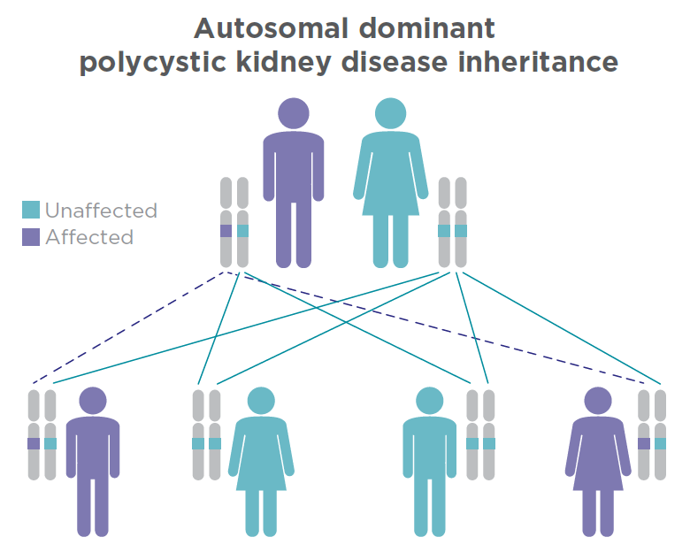
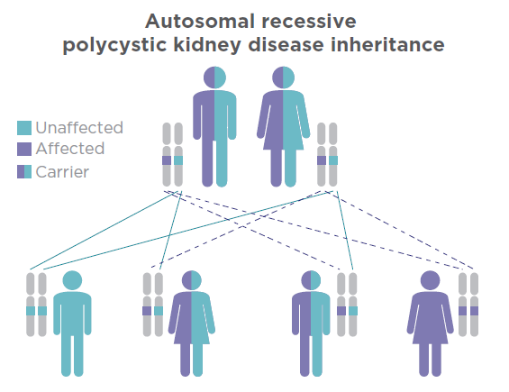
ADPKD vs. ARPKD: inheritance
Dominant
Genes: PKD1 or PKD2
Gene: PKHD1
PKD Patient Handbook & ARPKD Patient Handbook; PKD Foundation, www.pkdcure.org

Slide 11
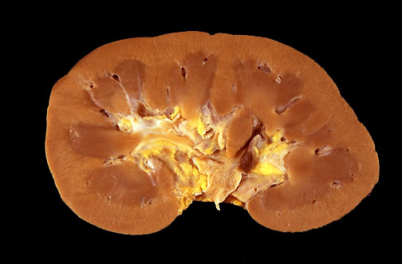
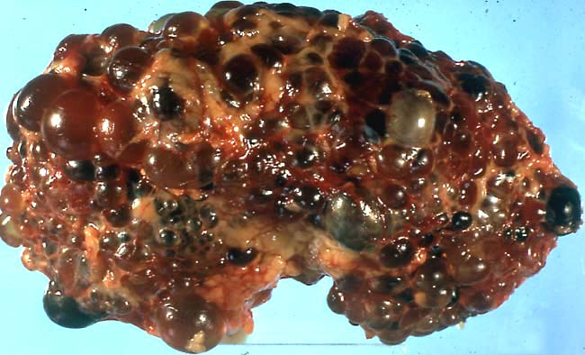
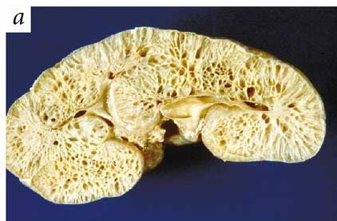
Kidney cysts: ADPKD vs. ARPKD
Normal
ADPKD
ARPKD
Larger bubble-like cysts throughout the kidney
Tiny, tubular cysts, often more in the central part of the kidney (medulla)

Slide 12
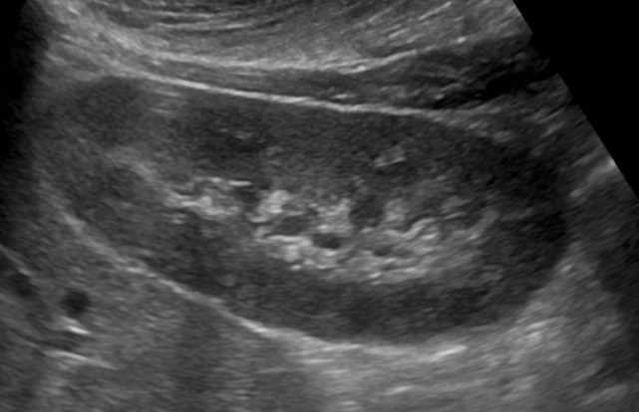
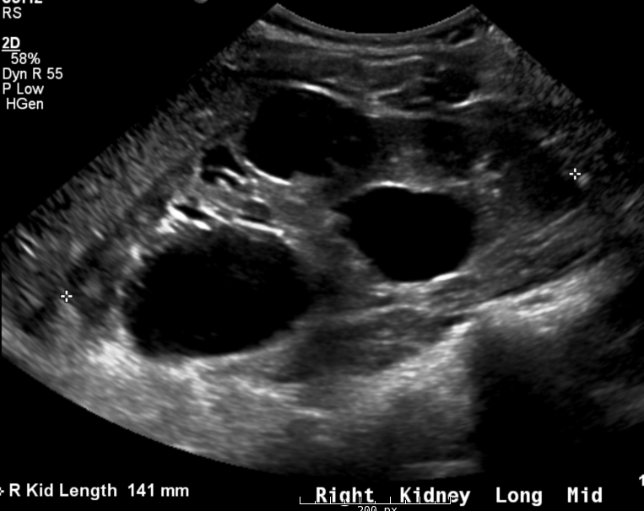
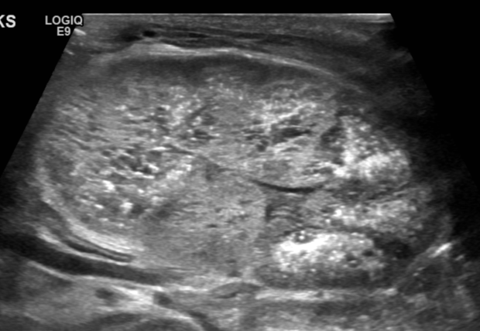
Ultrasound: ADPKD vs. ARPKD
Normal
ADPKD
ARPKD
Larger bubble-like cysts, often in the cortex (outer part)
Few or no visible cysts, kidneys “echogenic” = bright

Slide 13
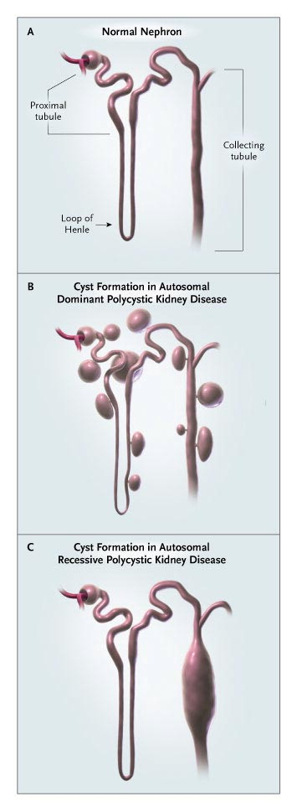
How do kidney cysts form?
Normal ADPKD ARPKD
Wilson PD. N Engl J Med 2004;350:151-164.
Notes:
Figure 2. Mechanisms of Cyst Formation in Polycystic Kidney Disease. Cysts originate as expansions of the renal tubule (Panel A). In autosomal dominant polycystic kidney disease, cystic outpushings arise in every tubule segment and rapidly close off from the nephron of origin (Panel B). By contrast, in autosomal recessive polycystic kidney disease, cysts are derived from collecting tubules, which remain connected to the nephron of origin (Panel C).

Slide 14
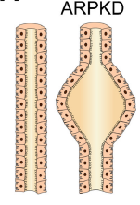
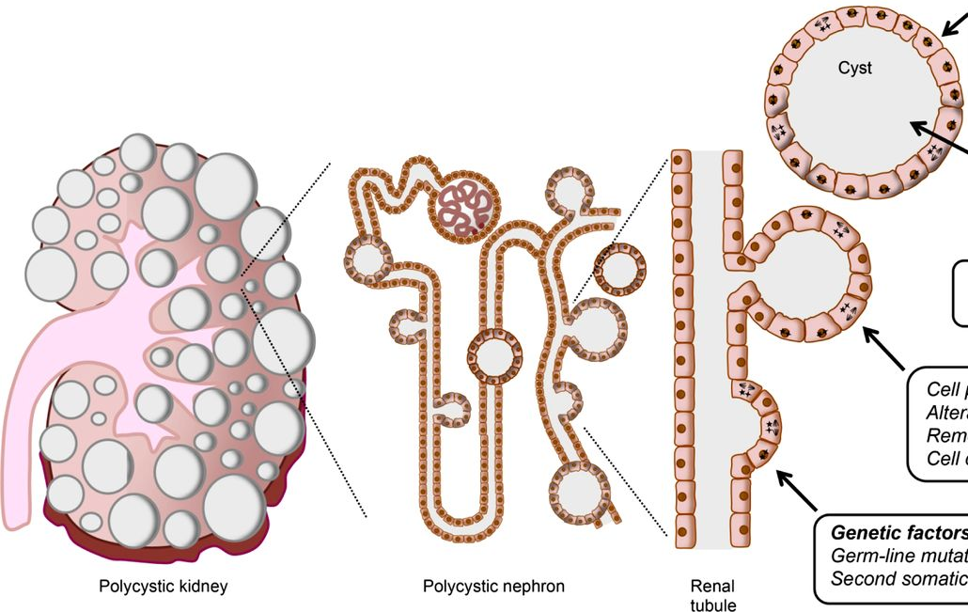
how do Cysts form and grow?
ARPKD
2. Excess fluid secreted into cysts and tubule cells keep multiplying
(influenced by vasopressin, cAMP, EGF, Src)
ADPKD
1. Genetic mutation causes tubule cells to grow & multiply abnormally
Blanco G & Wallace DP. Am J Physiol 2013; Staruschenko A. Compr Physiol 2012

Slide 15
ADPKD vs. ARPKD
PKHD1
PKD1
PKD2
Even though ADPKD and ARPKD are different diseases caused by different genes, similar mechanisms cause cysts in both diseases
Research in ADPKD and ARPKD often goes hand-in-hand, and discoveries in one disease help us learn about the other

Slide 16
ADPKD vs. ARPKD
 | ADPKD | ARPKD
Gene(s) | PKD1 (85%), PKD2 (15%) | PKHD1
Incidence | ~1 in 1000 people | ~1 in 20,000 people
Cyst type | Large, bubble-like cysts | Small tubular cysts
Imaging (US) | Large kidneys with visible round cysts | Large, echogenic (bright) kidneys, no/few visible cysts
Age at ESRD | Late adulthood (50s-70s) | Childhood - young adulthood
Associated problems | Liver cysts, brain aneurysms | Congenital hepatic (liver) fibrosis, portal hypertension

Slide 17
ARPKD: clinical features

Slide 18
Autosomal recessive polycystic kidney disease (ARPKD)
Previously called infantile polycystic kidney disease
Incidence ~1 in 10,000-40,000 births
Carrier rate ~1 in 70-100 people

Slide 19
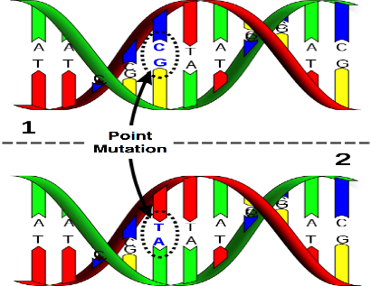
Genetics of ARPKD
PKHD1 gene, which makes a protein called fibrocystin/polyductin
There are many different mutations described, so most families have “private mutations”

Slide 20
ARPKD: Clinical features
Highly variable presentation:
  ~1/3 of patients
    “classic” neonatal (newborn) presentation:
      low amniotic fluid (oligohydramnios)
      very enlarged kidneys
      underdeveloped lungs (pulmonary hypoplasia)
      even with modern medical care, unfortunately ~30% of babies die
  ~2/3 of patients
    present in later childhood / adulthood, sometimes with liver-predominant disease
Adeva M. et al. Medicine 2006

Slide 21
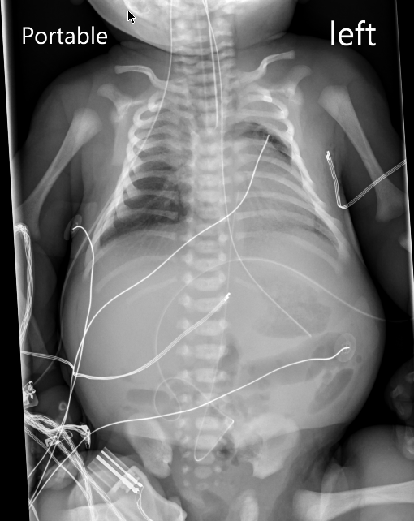
Newborns with ARPKD
Breathing (respiratory) problems:
  main cause of illness and death
  underdeveloped lungs (due to low amniotic fluid) + very enlarged kidneys making it difficult to expand lungs properly
  ~40% of babies require ventilator¹
  pneumothorax (collapsed lung) relatively common
Feeding difficulties due to massively enlarged kidneys
  often require NG or G-tube feeding
¹Guay-Woodford LM & Desmond RA, Pediatrics 2003

Slide 22
Newborns with ARPKD
Surgery to remove kidney(s) (nephrectomy)
  Sometimes surgical removal of one or both kidneys is done to try to improve breathing and feeding (to make more room in the abdomen)
  Best approach is unclear
  Significant surgical risks + earlier need for dialysis need to be balanced with any possible benefits
Hartung EA & Guay-Woodford LM, Pediatrics 2014

Slide 23
ARPKD: Other clinical features
Hypertension (high blood pressure)
  to be discussed by Dr. Meyers
Congenital hepatic fibrosis & portal hypertension
  to be discussed by Drs. Wehrman, Loomes, and Wen
Growth problems
  well-known complication in children with CKD from any cause
  observed in ~30% of children in North American ARPKD study¹
  some early studies suggested that children with ARPKD have growth problems out of proportion to CKD severity
  In CKiD cohort study, growth impairment was similar in children with ARPKD compared to those with other congenital causes of CKD²
¹Guay-Woodford LM. Pediatrics 2003; ²Hartung EA. Front Pediatr 2016

Slide 24
ARPKD: other clinical features
Learning difficulties
  Children with CKD from any cause are at risk for learning problems
  In CKiD cohort study, neurocognitive abilities in children with ARPKD were similar to those with other congenital causes of CKD¹ (scores slightly below average compared to healthy children)
¹ Hartung EA, Pediatr Nephrol 2014

Slide 25
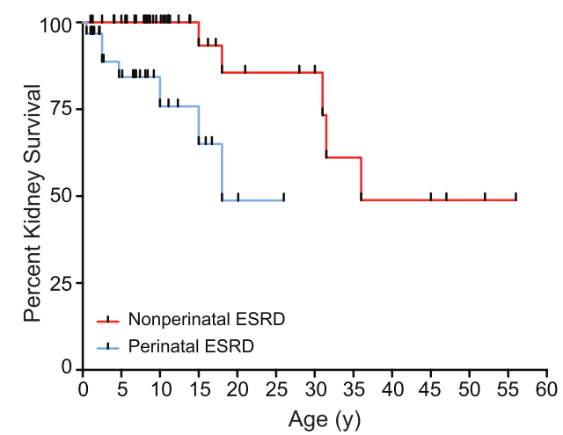
ARPKD: kidney outcomes
Chronic kidney disease: age at progression to end stage kidney disease (ESKD) depends on age at presentation. In NIH cohort (n=73)¹:
  Neonatal presenters: 25% ESKD by age 11 years
  Later presenters: 25% ESKD by age 32 years
¹Gunay-Aygun M. et al, CJASN 2010

Slide 26
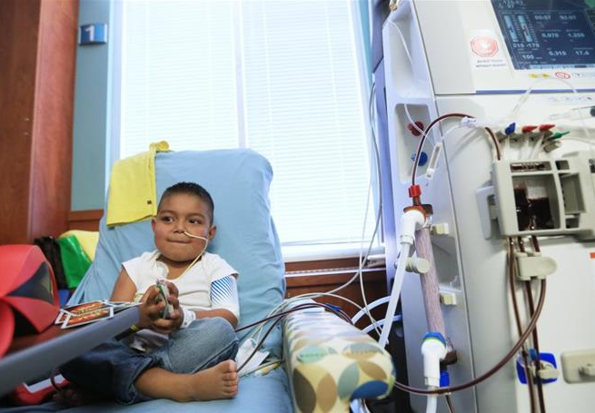
ARPKD: End stage kidney disease
Dialysis: replaces some functions of the kidneys after they fail (removing waste products and extra water, balancing electrolytes)
  Peritoneal dialysis
    Catheter surgically placed in abdomen
    Fluid is put in and drained out for multiple cycles nightly using a PD cycler machine at home
    Native kidneys may need to be removed to allow PD
  Hemodialysis (blood dialysis)
    Catheter or fistula surgically placed in large vein
    Child comes to dialysis center at hospital/clinic 3-4 times per week for ~4 hours
Kidney Transplant
  Will be discussed in detail by Dr. Meyers
ARPKD Patient Handbook; PKD Foundation, www.pkdcure.org

Slide 27
ARPKD: other kidney manifestations
Acidosis: low serum bicarbonate or CO₂ levels due to inability to get rid of acid in the urine
  may need bicarbonate or citrate supplements
Low sodium levels (hyponatremia) in newborn period; ~25% of patients¹
  ? due to inability to properly dilute urine (not excess sodium loss)
  Fluid restriction (e.g. concentrating feeds) or furosemide usually preferred over sodium supplementation (can worsen HTN)
¹Guay-Woodford LM. Pediatrics 2003

Slide 28
ARPKD: other kidney manifestations
Urine concentrating defect: may make larger amounts of urine than normal
  may cause bedwetting
  risk for dehydration
Risk of urinary tract infections (UTI)
  UTIs reported in 20-50% of patients¹
  May be due to poor urine flow in cystic tubules
¹Hartung EA & Guay-Woodford LM. Pediatrics 2014

Slide 29
Key take-home points
ADPKD and ARPKD are different diseases, but mechanisms causing cyst growth are similar - research in one disease may benefit the other
The clinical features and kidney outcomes of ARPKD can be highly variable, and depend on the age at presentation

Slide 30
Questions?

Slide 31
Additional Reading
Hartung EA, Guay-Woodford LM. Autosomal Recessive Polycystic Kidney Disease: A Hepatorenal Fibrocystic Disorder With Pleiotropic Effects. Pediatrics. 2014;134(3):e833-845
Guay-Woodford LM, Bissler JJ, Braun MC, et al. Consensus Expert Recommendations for the Diagnosis and Management of Autosomal Recessive Polycystic Kidney Disease: Report of an International Conference. J Pediatr. July 2014

