Slide 1
Liver Transplantation and ARPKD
Jessica Wen, M.D.
The Children’s Hospital of Philadelphia
Nov. 3, 2018

Slide 2
Objectives
  Primary functions of the liver
  Indications for Liver Transplant
  Process of liver transplant evaluation and listing
  Liver transplant surgery
  Unique challenges in ARPKD and liver transplant

Slide 3
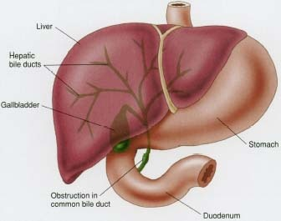
Primary Functions of the Liver
The liver has several important jobs, of which the main ones include:
  Manufacturing bile
  Making the proteins, including clotting factors
  Metabolize sugar and protein, fat- converting the food we eat into chemicals necessary for growth
  Detoxify
  Maintain portal flow

Slide 4
Liver Transplantation - History
1963 - First liver transplants performed at 3 separate institutions, each resulting in death of the recipient
1967 - Successful transplants were done (the first in a child) but 1 year survival rates were dismal (30%).
1978 - The introduction of cyclosporine rapidly improved 1 year survival rates to up to 80% (for adults) and revolutionized the field of solid organ transplantation.

Slide 5
Liver Transplantation - History
1980s - Numerous refinements of surgical techniques, organ procurement, preservation. Reduced size and split techniques introduced.
1989 - The first US living-donor (adult-to-child) liver transplantation was performed.
1993 - FDA approval of Tacrolimus (FK506) for primary immunosuppression.
Current - Liver Transplantation is well established as useful therapy for children with end stage liver disease and for treatment of metabolic diseases correctable with hepatic replacement.

Slide 6
Common Indications for OLT in Pediatric Liver Disease
Complications of cholestasis
  Failure to thrive, pruritis
Complications of synthetic failure
  Coagulopathy, low albumin
Complications of metabolic failure
  Low blood sugar
Complications of immune dysfunction
  Biliary infections, peritonitis

Slide 7
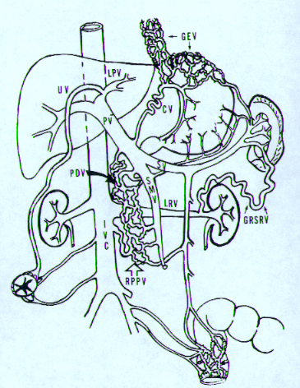
Complications of portal hypertension
  Splenomegaly
  Ascites/peritonitis
  Varices
  Hepato-pulmonary syndrome
  Caput medusa
  hemorrhoids

Slide 8

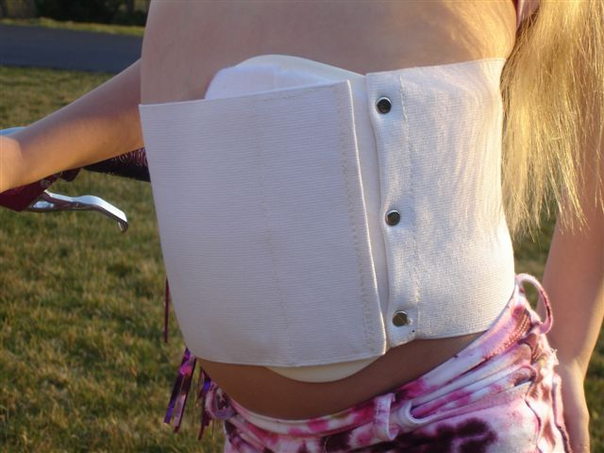
Spleen guard

Slide 9
“Anything from the organ cart today, Mr.. Harrelson?”

Slide 10
Indications for OLT
A chronic liver disease is not an absolute indication for transplantation
A life threatening complication of liver disease is an indication for transplant (as are certain metabolic and malignant diseases)
Given the seriousness of transplantation and the shortage of suitable donor organs, liver transplant should be avoided when possible
Medical therapy for all complications of liver disease should be aggressively pursued to postpone or prevent need for liver transplantation.

Slide 11
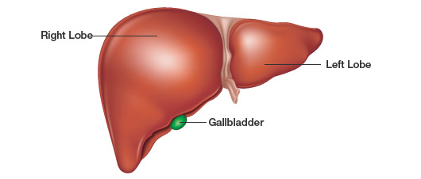
Types of liver transplant
Living Donor
      Split/Segmented Liver
Deceased Donor
      Whole Liver
      Split/Segmented Liver

Slide 12
Evaluation
Consult to evaluate for transplant
Family meeting
  Educational materials provided to the family
Patient undergoes extensive workup
  Surgical Evaluation
  Laboratory studies
  Radiology imaging
    Liver Doppler U/S
    Neck vessels
    ECHO
  Anesthesia Consult
  Psychosocial Consult
  Transplant Pharmacist Consult
  Nutrition Consult
  Financial counseling

Slide 13
Evaluation of Children for Liver Transplantation
Major goal of evaluation:
  to determine if the child is likely to benefit from OLT
Additional goals:
  consider alternative management
  predict optimal timing
  maximize nutritional/medical Rx
  provide education to patient and family

Slide 14
Listing
Patient data entered into UNOS (United Network of Organ Sharing) online secure system
Assigned a “score”
  End-stage liver disease score (MELD/PELD)
  Calculation based on lab values and growth measures
  Higher score indicates more urgent need for transplant
  Exception points - Given via review board for patients with severity of disease not reflected by lab values

Slide 15

Waiting….

Slide 16
Organ Allocation
Livers are matched by
  Size
  Blood Type
  HLA typing is not necessary for liver transplant
Allocation is based on severity of illness, or “sickest first”

Slide 17
Pediatric Liver Transplant
In 2016
Adult liver transplant 7841
Pediatric liver transplant 573
5 year graft survival: 81.5%
5 year patient survival: 86.2%
UNOS: www.unos.org
SRTR: www.ustransplant.org

Slide 18
Unique considerations in ARPKD
Kidney and liver transplantation is sometimes needed
Question regarding timing and sequence of transplants
Question about prognosis/outcome after tranplant

Slide 19
APRKD and Transplants
Retrospective cohort study of all pediatric kidney and liver transplants performed in the U.S. from 1990 to 2011 for fibrocystic liver disease
Data Source: Scientific Registry of Transplant Recipients (SRTR)
  National database of all donors, wait-listed candidates and transplant recipients in the U.S.
  Age < 18 years at initial liver or kidney transplant
  Kidney transplant recipients with diagnosis code: polycystic kidney disease, nephronophthisis
  Liver transplant recipients with diagnosis code: congenital hepatic fibrosis, Caroli’s disease
Notes:
Retrospective cohort of all pediatric transplant recipient in the U.S.
Kidney
Liver criteria
Study design: re
Participants: inclusion, exclusion
Outcome:

Slide 20
Result
Initial organ transplant | Number of patients | Age at initial transplant (IQR) | Death (%)
Liver | 73 | 8.7 (2.3, 13.3) | 17 (23%)
Kidney | 602 | 9.9 (3.5, 14.8) | 59 (10%)
Simultaneous liver/kidney | 41 | 9.2 (5.3, 13.8) | 5 (12%)
Total | 716 | 9.7 (3.6, 14.7) | 81 (11%)
Median follow up 8.5 years (IQR 4.7, 13.3)

Slide 21
Subsequent transplantation in organ transplant recipients
Initial organ transplant | Re-transplant | Re-transplant with SLK | Mean duration (yrs)* | Median age (yrs)
Liver | 14 (19%) | 0 (0%) | 0.2 (0.01, 3.6) | 11.8 (5.2, 14.2)
Kidney | 116 (19%) | 14 (2%) | 7.7 (3.3, 10.5) | 17.6 (11.3, 22.1)
2 of the 41 SLK (5%) were re-transplanted. 1 liver then kidney, 1 SLK.
*Interquartile range in parenthesis
SLK- simultaneous liver kidney transplant
Notes:
Do you have more info about the SLK re-transplant? What was the duration between each of the transplant?

Slide 22
Subsequent transplantation in alternate organ
Initial organ transplant | Transplant in alternate organ | Mean duration (yrs)* | Median age (yrs)
Liver | 4 (5%) | 8 (6, 10.4) | 14.5 (10.9, 19.5)
Kidney | 15 (2%) | 4.6 (3.4, 8.6) | 9.5 (7.2, 16.7)

Slide 23
Conclusions
Patients with fibrocystic liver disease are much more likely to receive kidney transplants then liver transplants
Risk of needing transplantation in an alternate organ is low in both liver and kidney transplant recipients, suggesting patients with end-stage disease of one organ are unlikely to develop end-stage disease in the other organ.
Of the patients who underwent SLK, the mortality rate at end of follow up period is comparable to single organ transplants

Slide 24
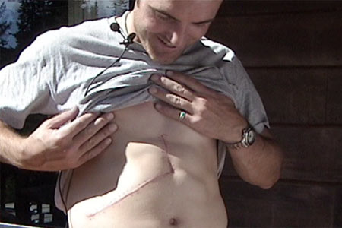
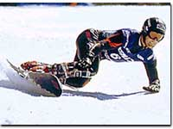
Chris Klug
Liver transplant recipient 2000
Olympic bronze medalist 2002

Slide 25
Summary
Liver Transplantation is a successful treatment for serious liver disease
Outcome is very good and normal quality of life is the goal
Special consideration in PKD/CHF should be given to status of kidney disease and possible need for liver and kidney transplant

