Slide 1
ARPKD: imaging research and clinical trials
Erum Aftab Hartung, MD, MTR
Assistant Professor of Pediatrics
Division of Nephrology, CHOP
Perelman School of Medicine at the University of Pennsylvania
ARPKD-CHF Conference: Empowering the Patient
Saturday November 3, 2018

Slide 2
Objectives
To review current research studies in ARPKD
ARPKD database: UAB Hepatorenal Fibrocystic Disease Core
CHOP Research studies
Novel Imaging in ARPKD
Clinical trial - tesevatinib

Slide 3
ARPKD database
University of Alabama at Birmingham (UAB) Hepatorenal Fibrocystic Diseases (HRFD) Core Center
Led by Dr. Lisa Guay-Woodford (Children’s National Medical Center) and UAB colleagues
Funded by NIH/NIDDK
Focused on understanding causes of cystic kidney diseases (ARPKD + other genetic kidney-liver diseases) and the development of new therapeutic strategies

Slide 4
ARPKD database: UAB HRFD Core center
Anonymous
No study visits needed - just sign consent forms and UAB team coordinates obtaining medical records/samples
Three components:
Clinical database
Info from patient’s medical records is entered into database
Tissue repository
Kits are sent to request existing tissue samples (e.g. kidney/liver) from pathology labs
Genetic studies
Kits are sent to obtain a blood sample during a regular lab draw

Slide 5
ARPKD database: UAB HRFD Core center
Contact: Elena Gibson, RN
202-476-2197
egibson@childrensnational.org

Slide 6
ARPKD studies underway at chop
ARPKD Novel imaging biomarkers in ARPKD
Funded by NIH/NIDDK grant (K23-DK109203)
A Phase 1, Safety, Pharmacokinetic, Single Ascending Dose Study of Tesevatinib in Pediatric Subjects With ARPKD (NCT03096080)
Funded by Kadmon Corporation, LLC

Slide 7
Novel imaging biomarkers in ARPKD study
Goal: To develop new, non-invasive imaging methods to measure progression of kidney and liver disease in ARPKD
Why?
A major barrier to performing clinical trials of potential new drugs in ARPKD patients is the lack of accurate ways to measure disease progression within a realistic time frame (2-3 years)
Current methods (blood tests, standard ultrasound or MRI) are not accurate enough to detect changes in the short term

Slide 8
Novel imaging biomarkers in ARPKD study
Who?
Patients with a diagnosis of ARPKD, from birth to 21 years old
Healthy children for comparison
What is involved?
One study visit each year for up to 4 years (CHOP Main campus), with:
Interviews & physical exam
Blood and urine tests
Ultrasound of the liver, spleen, and kidneys
MRI of the liver, spleen, and kidneys (only in children old enough to lie still for up to 1 hour, usually at least 7 y/o)

Slide 9
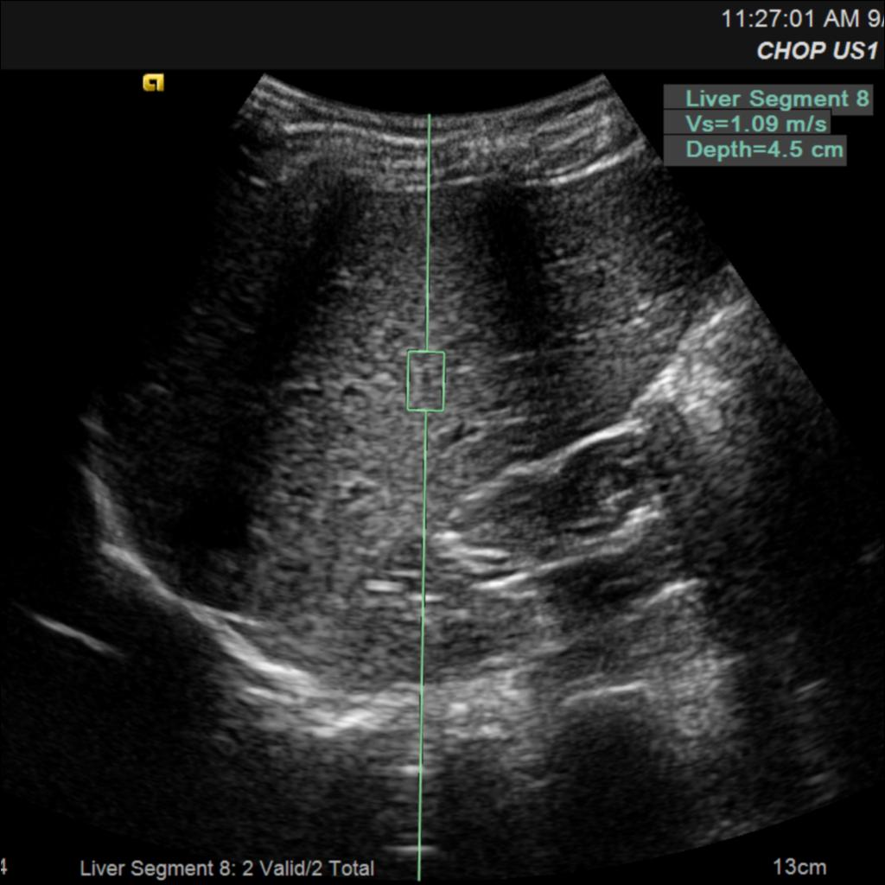
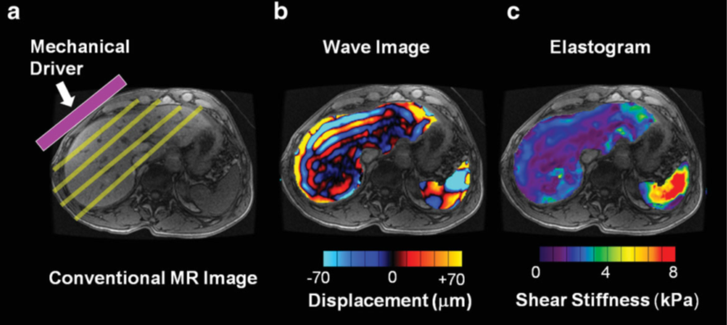
Novel imaging biomarkers in ARPKD study
US elastography
What are the imaging methods?
Liver and spleen: measurements of tissue stiffness to quantify liver fibrosis and portal hypertension
Ultrasound (US) elastography
Magnetic resonance (MR) elastography
MR elastography

Slide 10
Novel imaging biomarkers in ARPKD study
What are the imaging methods?
Kidneys: measurements of tissue stiffness and cyst burden
US elastography
Multiple MRI sequences (quantitative T2 mapping, diffusion)
Healthy 12 y/o
ARPKD, 13 y/o

Slide 11
Novel imaging biomarkers in ARPKD study
US elastography
27 ARPKD patients and 24 healthy children have participated thus far
Findings to date:
US elastography of the liver appears to be helpful in detecting liver fibrosis and portal hypertension in children with ARPKD
MR elastography also appears promising to detect liver fibrosis
MR elastography
Hartung EA et al., manuscript under review; Sharma S et al., ASN abstract 2017

Slide 12
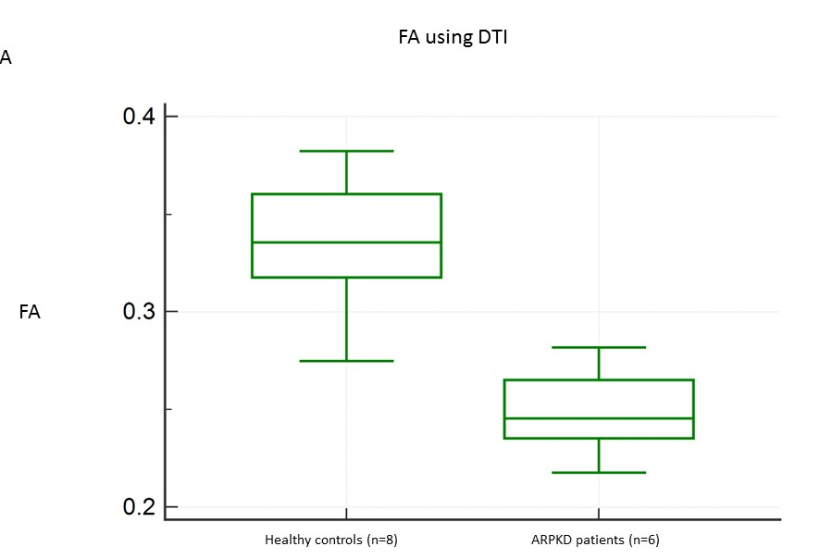
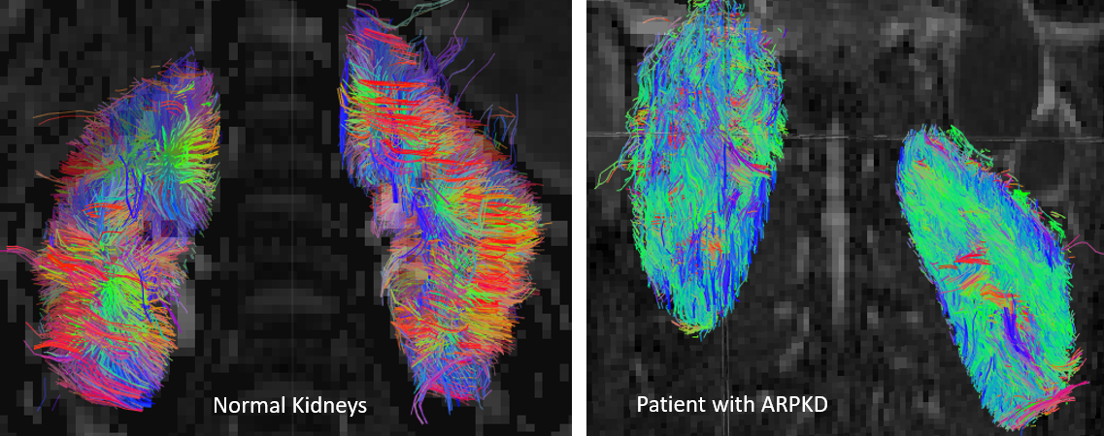
Novel imaging biomarkers in ARPKD study
FA measured by DTI-MRI
Healthy vs. ARPKD
Findings to date:
Diffusion tensor MRI shows significant kidney tissue disorganization (lower fractional anisotropy, FA) in ARPKD patients compared to healthy controls

Slide 13
Tesevatinib clinical trial

Slide 14
how do Cysts form and grow?
ARPKD
2. Excess fluid secreted into cysts and tubule cells keep multiplying
(influenced by vasopressin, cAMP, EGF, Src)
ADPKD
1. Genetic mutation causes tubule cells to grow & multiply abnormally
Blanco G & Wallace DP. Am J Physiol 2013; Staruschenko A. Compr Physiol 2012

Slide 15
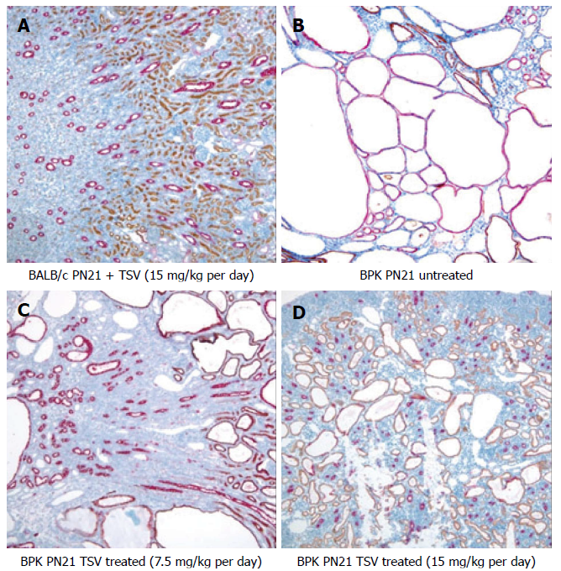
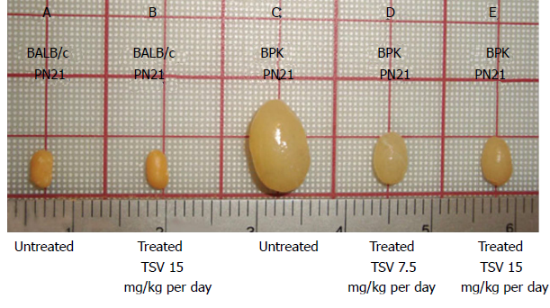
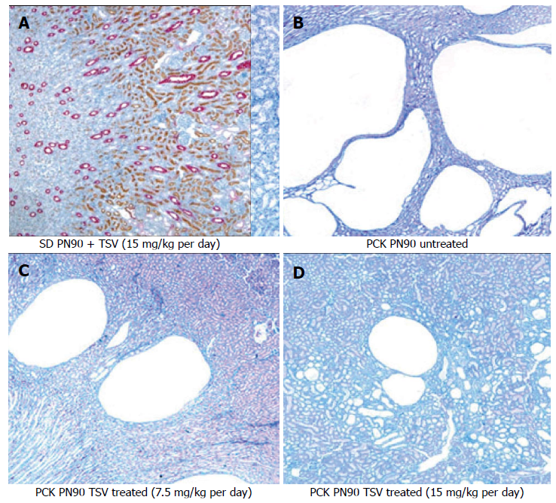
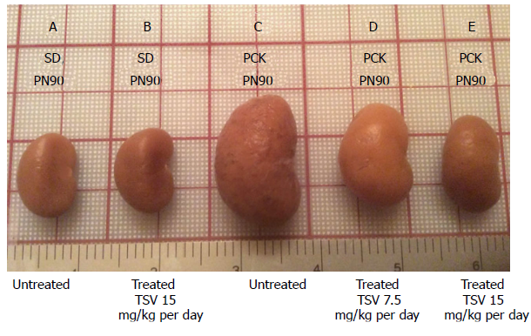
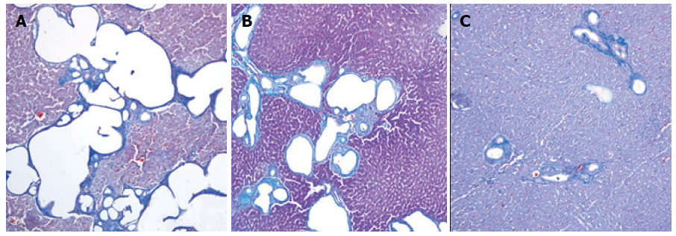
ARPKD: drug trials
P21 Kidneys
Tesevatinib
multi-kinase inhibitor (EGF, Src, cAMP)
Improved kidney & liver disease in 2 different animal models of ARPKD (BPK mice and PCK rats)¹
BPK mice
(treated P4-P21)
BPK untreated
Control + TSV
P21 Liver
BPK + TSV low
BPK + TSV high
BPK untreated
BPK + TSV high
BPK + TSV low
P90 Kidneys
PCK rats
(treated P30-90)
Control + TSV
PCK untreated
P90 Liver
¹Sweeney WE et al. World J Nephrol 2017
PCK + TSV low
PCK + TSV high
PCK untreated
PCK + TSV low
PCK + TSV high

Slide 16
ARPKD Tesevatinib study
A Phase 1, Safety, Pharmacokinetic, Single Ascending Dose Study of Tesevatinib in Pediatric Subjects With ARPKD (www.ClinicalTrials.gov, NCT03096080)
Goal: To study the pharmacokinetics (how the drug is processed in the body) and safety of a single dose of tesevatinib in children with ARPKD
Why?
Phase 1 clinical trial (earliest phase) to find out the best dose and ensure safety before moving to a multiple-dose trial
Who?
Children with ARPKD aged 5-12 years old
GFR ≥ 50, plus other eligibility criteria

Slide 17
ARPKD Tesevatinib study
What is involved?
6 total visits over ~6 weeks
A single dose of tesevatinib by mouth, at one of 3 dose levels
6 patients have completed dose level 1, currently recruiting for dose level 2
Study procedures include vision and hearing tests, ECG, echocardiogram, ultrasound, IV placement, urine and blood testing, and physical exam

Slide 18
ARPKD studies at chop
Informational flyers for all research studies are in the back
Interested in participating? Please contact me or my study coordinator:
Mohini Dutt
267-425-3933
duttm2@email.chop.edu
Erum A. Hartung, MD, MTR
215-590-2449
hartunge@email.chop.edu

Slide 19
Key take-home points
Every day brings hope for new research advances in ARPKD
There are many opportunities to get involved!

Slide 20
Questions?

Slide 21
Supplemental slides: potential future drug trials

Slide 22
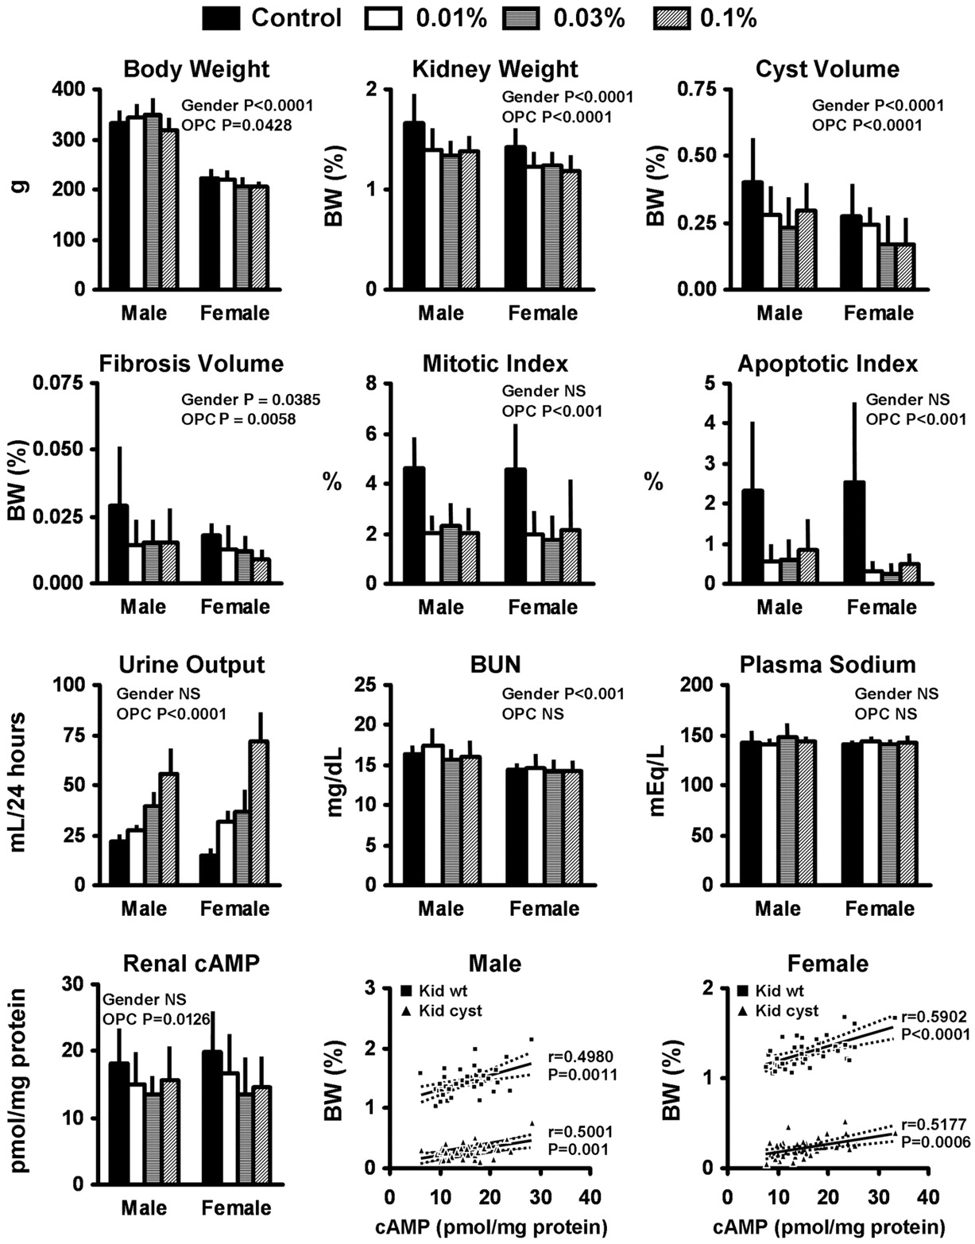
ARPKD: drug trials
Tolvaptan
Vasopressin receptor (V2R) antagonist
Pre-clinical trials in PCK rat showed some improvements in cyst & kidney volume and fibrosis with tolvaptan
No pediatric trials yet in ARPKD
¹Wang X et al. JASN 2005

Slide 23
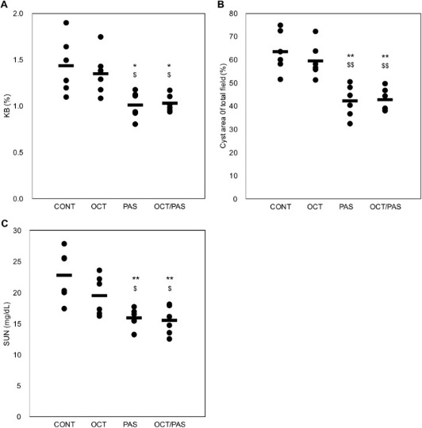
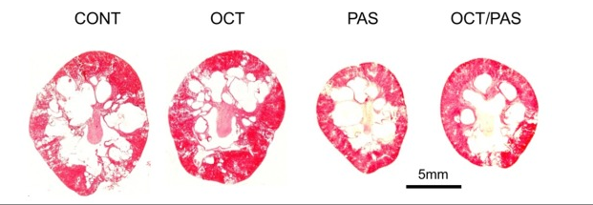
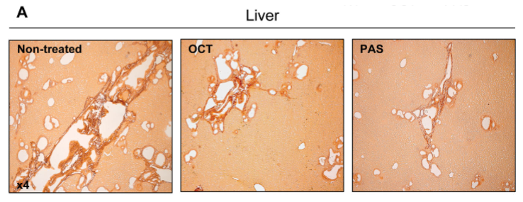
ARPKD: drug trials
Kidney weight per body weight (%)
Cystic area (%)
Octreotide / pasireotide
Somatostatin analogs → decrease cAMP activity
Appear effective for kidney¹ and liver² disease in PCK rat model
No pediatric trials yet in ARPKD
BUN (mg/dL)
¹Kugita M et al. PLoS One 2017;
²Masyuk et al. Hepatology 2013

